Slide 1
Standard Errors and Confidence Intervals
SSI II
Jan 29, 2019

Slide 2
Previously
Sampling
Expected value and standard error for sums
Central Limit Theorem
Statistical inference

Slide 3
Essential Questions
How do we make inferences from the sample to the population?
Where do confidence levels come from?

Slide 4
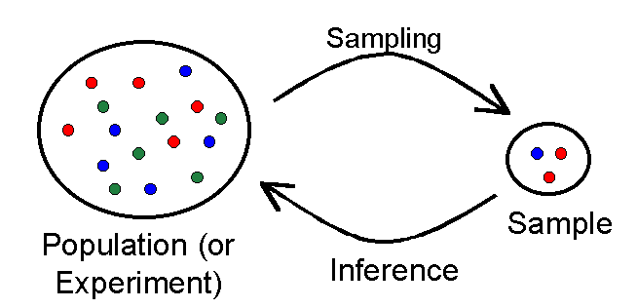
Goal of Statistical Inference

Slide 5
Simple Random Sampling
Every member of the population has an equal chance of being selected into the sample.
The selection of one member is independent from the selection of another member.
Thus, it is selection by pure chance.
Notes:
As you might imagine, it is very easy for a sample to be biased. Thus, there are strategies that researchers adopt in an attempt to eliminate or decrease the bias in their sample. One of these strategies is the use of simple random sampling. Simple random sampling occurs when every member of the population has an equal chance of being selected into the sample. In addition, the selection of one member is independent from the selection of another member. In theory, then, the strategy of simple random sampling involves selection into a sample by pure chance.

Slide 6
Importance of Random Sampling
If we do not sample by pure chance, problems can result.
Consider the following examples...
Notes:
To see why random sampling is important, consider the following ways that a sample can be obtained. To build on your understanding of sample and population, identify both of these and then consider the problem(s) with how the sample was selected.

Slide 7
Sampling Example 1
A substitute teacher wants to know how students in the class did on their last test.
She asks only the 10 students sitting in the front row to report how they did on their last test and she concludes from them that the class did extremely well.
Sample? Population? Problems?
Notes:
In this example, a substitute teacher wants to know how students in the class did on their last test. She asks only the 10 students sitting in the front row to report how they did and concludes that the class did extremely well. What is the sample? What is the population? Can you identify any problems with choosing the sample in the way that the teacher did?

Slide 8
Answers
The sample is the 10 students sitting in the front row.
The population is all students in the class.
The problem is that the sample is biased.
Notes:
- The sample is the 10 students sitting in the front row.- The population is all students in the class.- The problem with choosing this sample is that it is biased. Those who sit in the front row of classes tend to be more interested in the class and tend to perform higher in the class than the students who sit in other places in the classroom. Thus, the sample may be performing much better than the population. If the substitute teacher puts every student's name in a hat and randomly chooses 10 names out of the hat, the sample would not be biased. Consider another example...

Slide 9
Sampling Example 2
A coach is interested in seeing how many cartwheels the average college freshman at his university can do.
The coach chooses eight volunteers, all of whom happen to be women, and concludes that college freshmen can do an average of 16 cartwheels in a row without stopping. Sample? Population? Problems?
Notes:
In this example, a coach is interested in seeing how many cartwheels the average college freshman at his university can do. The coach chooses eight volunteers, all of whom happen to be women, and concludes that college freshmen can do an average of 16 cartwheels in a row without stopping. What is the sample? What is the population? Can you identify any problems with choosing the sample in the way that the coach did? The sample includes the female students who volunteered to do cartwheels. - The population includes all freshmen at the university where the study was conducted. - The problem with choosing this sample is that, again, random sampling was not used and so generalizations back to the population can be grossly inaccurate. Rather than randomly sample from all college freshmen and ask them to turn cartwheels, the coach chose only women and chose only those who volunteered. First, we might assume that women generally outperform men in turning cartwheels (more women are in gymnastics, cartwheels tend to be an activity that little girls pursue more than boys) and so the number 16 would be biased. Second, those that volunteer to do cartwheels can probably do cartwheels very well. In other words, a person who can't do cartwheels probably would not volunteer to do them. Thus, the sample may be missing individuals who suffer in cartwheel abilities and hence, the sample inflates the number relative to the population.

Slide 10
Problems w/ Random Samples
Can be difficult to obtain
Not necessarily representative
Large sample sizes help
Notes:
Sometimes, it is simply not possible or feasible to take a simple random sampling. For instance, consider that both Dallas and Houston were vying to be hosts of the 2012 Olympics. And assume you were hired to assess whether Texans, as a whole, would prefer the Olympics to be in Dallas or Houston. Because you have already learned the difficulty of getting every single Texan's opinion, you know you must get a sample and you want to use a simple random sampling. However, even this may be very difficult. For instance, how will you get a hold of those individuals who don't vote, who don't have phones, and whose addresses have changed? What do you do with those individuals in the sample who happened to move from Texas to California? What do you do about the fact that since the beginning of the study, an additional 4,212 people moved to the state of Texas? As you can see, it is sometimes very difficult to develop a truly random procedure.
Recall that the definition of a random sample is a sample in which every member of the population has an equal chance of being selected. This means that the sampling procedure rather than the results of the sampling procedure defines what it means for a sample to be random. Random samples, especially if the sample size is small, are not necessarily even roughly representative of the population. For example, if a random sample of 12 were taken from a population with an equal number of males and females, there would be approximately a 1 in 5 chance that two thirds or more of the sample would be female. Such a sample would not be representative, although it would be random. In short, only with a large sample size will a random sample ensure an approximately representative sample.

Slide 11
Sample Size Matters
A larger sample size will reduce the standard error (estimate of the error)
The size of the population does not matter

Slide 12
Polls and Approval Ratings
There are over 250 million adults in the US
In a recent Gallup poll, 36% of those sampled approve of the way Trump is doing his job
The margin of error is plus or minus 3%
(Pretend) it is a random sample of 1,500 people
How confident can we be from the sample that the true level of approval is within the range of 33%-39%?

Slide 13
Sampling Distribution
The distribution of the sample means generated by repeated random sampling

Slide 14
Sampling Distributions
Suppose we repeat the random sampling process many times and compute the sample mean each time
Due to randomness, each time we will get a different sample mean
To determine whether the sample mean is a good estimate of the population mean, we can investigate the properties of the sampling distribution (the distribution of randomly drawn sample means)

Slide 15
Data Distribution vs. Sampling Distribution
Household Incomes
Sample Means of Household Income
Notes:
From two different sources, but average income was around $72,000 and median income was $53,719

Slide 16
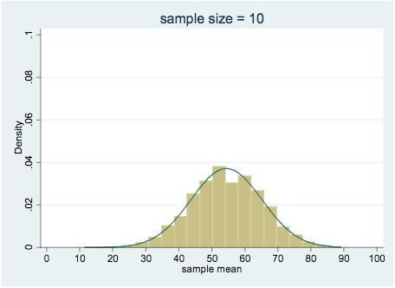
Observed Sample Means Sample size = 10; 10,000 Iterations

Slide 17
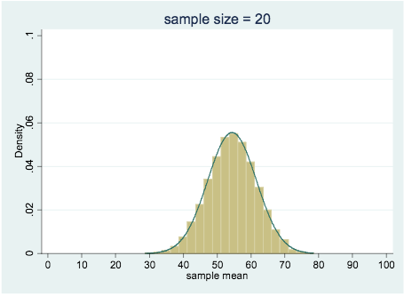
Observed Sample Means Sample size = 20; 10,000 Iterations

Slide 18
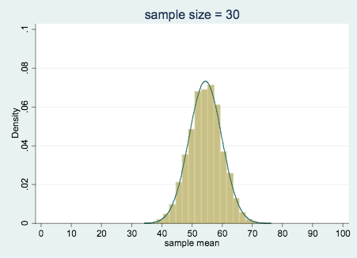
Observed Sample Means Sample size = 30; 10,000 Iterations

Slide 19
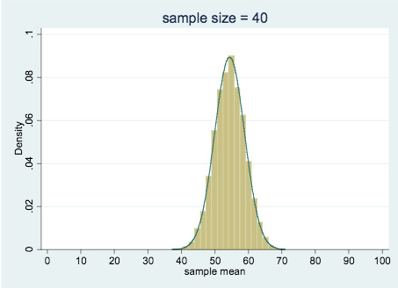
Observed Sample Means Sample size = 40; 10,000 Iterations

Slide 20
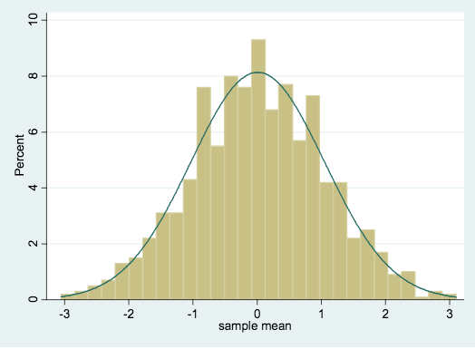
Normal Distribution

Slide 21

Central Limit Theorem
If the population variable has mean μ and standard deviation σ, then for random samples of size n, the distribution of the sample mean, x̅, has the following properties:
For a large enough n, x̅ is normally distributed
The average x̅ equals the population average μ
The standard error of the sample mean is:

Slide 22
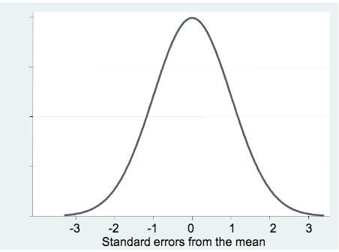
Normal Distribution
About 68% of sample means will be within ± 1 standard error from the population mean

Slide 23
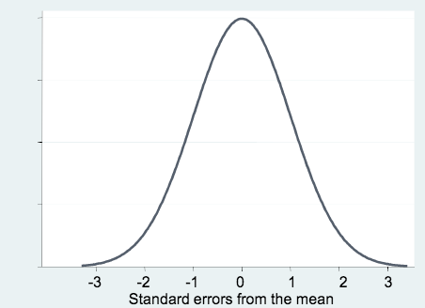
Normal Distribution
About 95% of sample means will be within ± 2 standard errors from the population mean

Slide 24
Normal Distribution
About 99% of sample means will be within ± 3 standard errors from the population mean

Slide 25

Central Limit Theorem
Also tells us that we can use the sample standard deviation as an estimate of the population standard deviation to compute the standard error:
From the Central Limit Theorem, we know that there is a 95% chance that the sample mean x̅=45 is within about 2 standard deviations of the population mean, μ, so
x̅ – 2SE < μ < x̅ + 2SE

Slide 26
Confidence Intervals
In general, the Central Limit Theorem implies that we can compute confidence intervals – for any given level of confidence, a range of values within which the (unknown) population mean lies
68% confidence interval: x̅ – SE < μ < x̅ + SE
95% confidence interval: x̅ – 2SE < μ < x̅ + 2SE
99% confidence interval: x̅ – 3SE < μ < x̅ + 3SE

Slide 27

Confidence Intervals
Compute the sample mean, x̅, and standard deviation
Compute the standard error, using the standard deviation and sample size, n:
With 95% probability, the true population mean is within about plus or minus two standard errors of the sample mean. The 95% confidence interval is therefore:
x̅ – 2SE < μ < x̅ + 2SE

Slide 28
Example
In a random sample of University of Chicago students, we find that 19% are from the mid-Atlantic region and the SE is 2% What is the 95% confidence interval?

Slide 29
Example
In a random sample of University of Chicago students, we find that 19% are from the mid-Atlantic region and the SE is 2% What is the 95% confidence interval?
x̅ – 2SE < μ< x̅ + 2SE
19-4 < μ < 19+4
15% - 23%

Slide 30
Example
Gallup poll from the beginning of class
N=1500
Sample mean - 39%
Sample standard deviation
Standard Error
95% and 99% confidence intervals
Margin of error (95%, 99%)

Slide 31
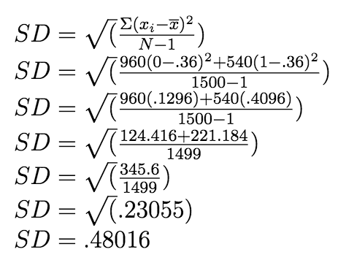
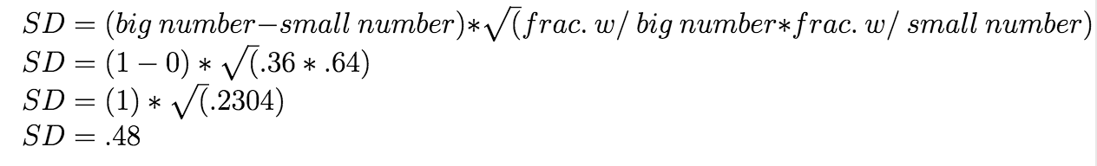
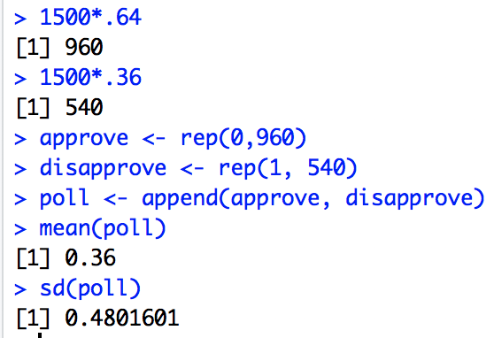
Example – Standard Deviation
Notes:
$ $\\$SD=\sqrt(\frac{\Sigma(x_i-\overline{x})^2}{N-1})$\\$SD=\sqrt(\frac{960(0-.36)^2+540(1-.36)^2}{1500-1})$\\$SD=\sqrt(\frac{960(.1296)+540(.4096)}{1500-1})$\\$SD=\sqrt(\frac{124.416+221.184}{1499})$\\$SD=\sqrt(\frac{345.6}{1499})$\\$SD=\sqrt(.23055)$\\$SD=.48016$$ $\\$SE=\frac{SD_x}{\sqrt{N}}$\\$SE=\frac{.48}{\sqrt{1500}}$\\$SE=\frac{.48}{38.73}$\\$SE=.01239$\\$ $\\$SE*2=.01239*2=.02478$\\$SE*3=.01239*3=.03717$\\

Slide 32
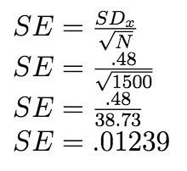
Example – Standard Error

Slide 33
Confidence Interval – 95%
x̅ – 2SE < μ < x̅ + 2SE
.36-.025 < μ < .36+.025
.335 < μ < .385
We can be 95% confident that the true level of Trump approval is between 33.5% and 38.5%
Caveat: assuming we had a random sample

Slide 34
Confidence Interval – 99%
x̅ – 3SE < μ < x̅ + 3SE
.36-.037 < μ < .36+.037
.323 < μ < .397
We can be 99% confident that the true level of Trump approval is between 32.3% and 39.7%
Caveat: assuming we had a random sample

Slide 35
Margin of Error – 95%
95% MoE= x̅ ± 2SE
95% MoE= .36 ± .025
Trump’s approval rating is 36%, with a (95%) margin of error of 2.5 points.

Slide 36
Margin of Error – 99%
95% MoE= x̅ ± 3SE
95% MoE= .36 ± .037
Trump’s approval rating is 36%, with a (99%) margin of error of 3.7 points.

Slide 37
Exercise
Consider a town of 25,000 voters. We draw a random sample of 1600 people and find that 57% are democrats with a standard deviation of 0.5%. What is the 95% confidence interval for the percentage of democrats among the 25,000 voters?
How would we find the 99%?

Slide 38
Summary
Statistical inference – learning about populations from random samples
Central limit theorem – important result about the sampling distribution of the sample mean
On average, sample mean will be accurate
Increase reliability by increasing sample size
Sample mean is normally distributed
Confidence intervals
Application of Central Limit Theorem
True population mean will fall within 2 standard errors of the sample mean 95% of the time

Slide 39
Essential Questions
How do we make inferences from the sample to the population?
Where do confidence levels come from?

Slide 40
Next time…
Univariate hypothesis tests

